Slide 1
TezCard
Be the Soul of DAOs

Slide 2
DAO has become a core component of Web3
Over the past 2021, the DAO’s treasury has grown from $400 million to $16 billion, a 40-fold increase, and its participation has grown from 13,000 to 1.6 million, according to DeepDAO, a DAO analytics platform.
With the development of DAO, the concept of subDAO began to appear. subDAO operates completely autonomous while remaining consistent with superDAO (or parentDAO).
DAOs have become a core component of Web3, and emerging ecosystems around DAOs are rapidly developing to support the core functions of DAOs.

Slide 3
SBT—The Soul Of the Web3
Based on the issuance and verification of SBT identity, individuals will build a social relationship network, and each bound account (Soul) and the community will jointly create more diversified Web3 assets, not just the current transferable financial assets.

Slide 4
The primitives of a DAO
We found that the primitives of a DAO are Voting and Membership management.
Voting
Membership Management

Slide 5
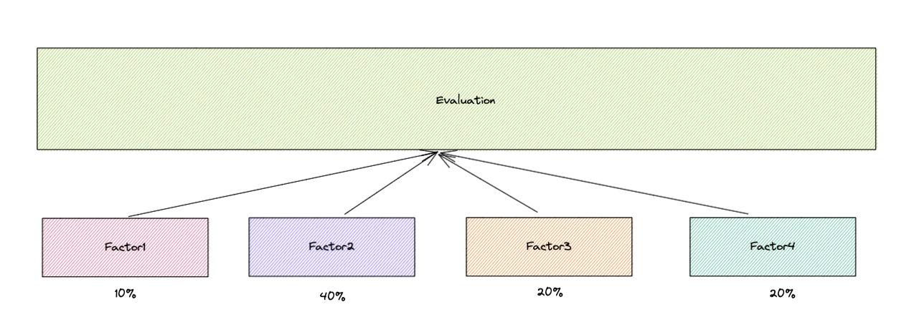
Evaluation Expression
User Rank = Factor Score * Factor Weight + ……..

Slide 6
How to verify the qualification
Fixed-rank threshold: For example, If the threshold is 100 and someone’s current score is 101, then the SBT would allow he/she to mint the SoulBound Token to join the DAO.
Time-elapsed ranking: For example, If the deadline is at block-level 10001, and accepts 10 candidates, someone's current ranking is at position 9, then the SBT would allow he/she to mint the SoulBound Token to join the DAO.

Slide 7
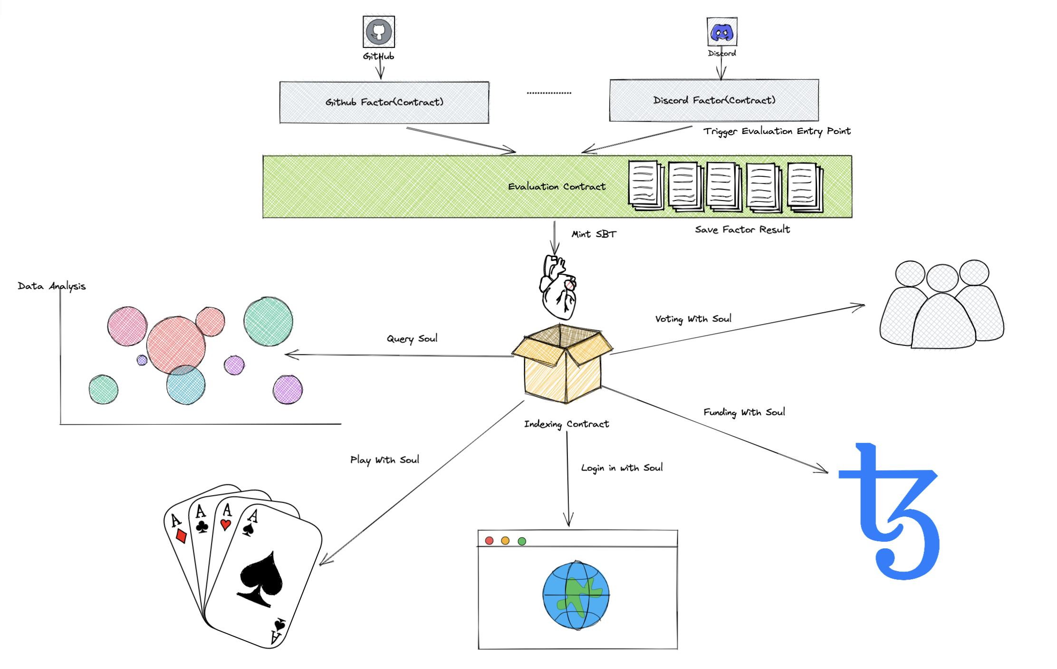
What is TezCard？
1.The best helper for DAO managers
2.DID for any Web3 App
In short, the TezCard is a toolbox without any tokenomics, just help DAO funders to build their own DAO.

Slide 8
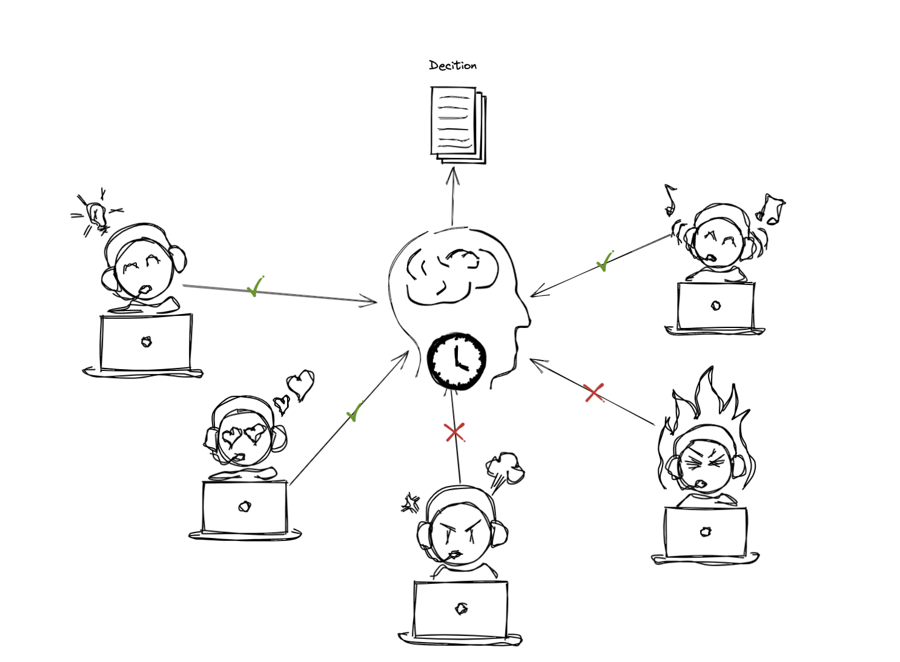
User story: Voting
1.Protect the voting from Dust Attack
2.Help DAOs govern better
3.Determination or Funding

Slide 9
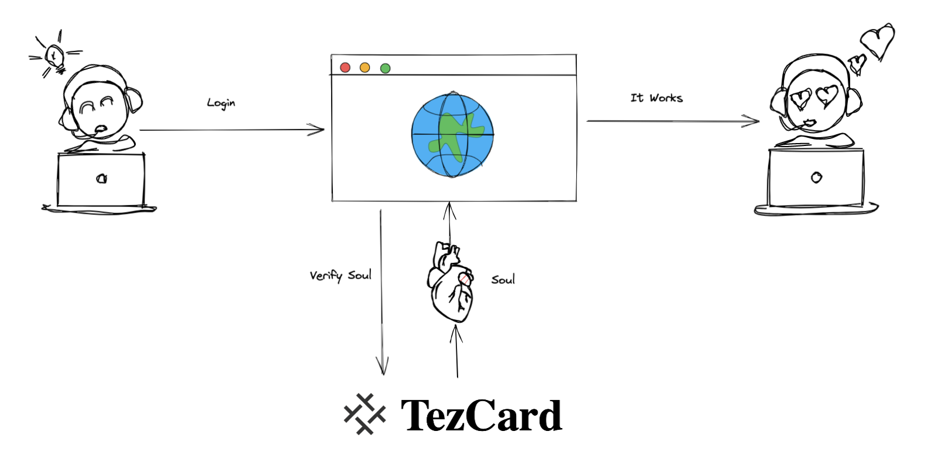
User story: Web2Login
Over TezCard DID login in Web2 website

Slide 10
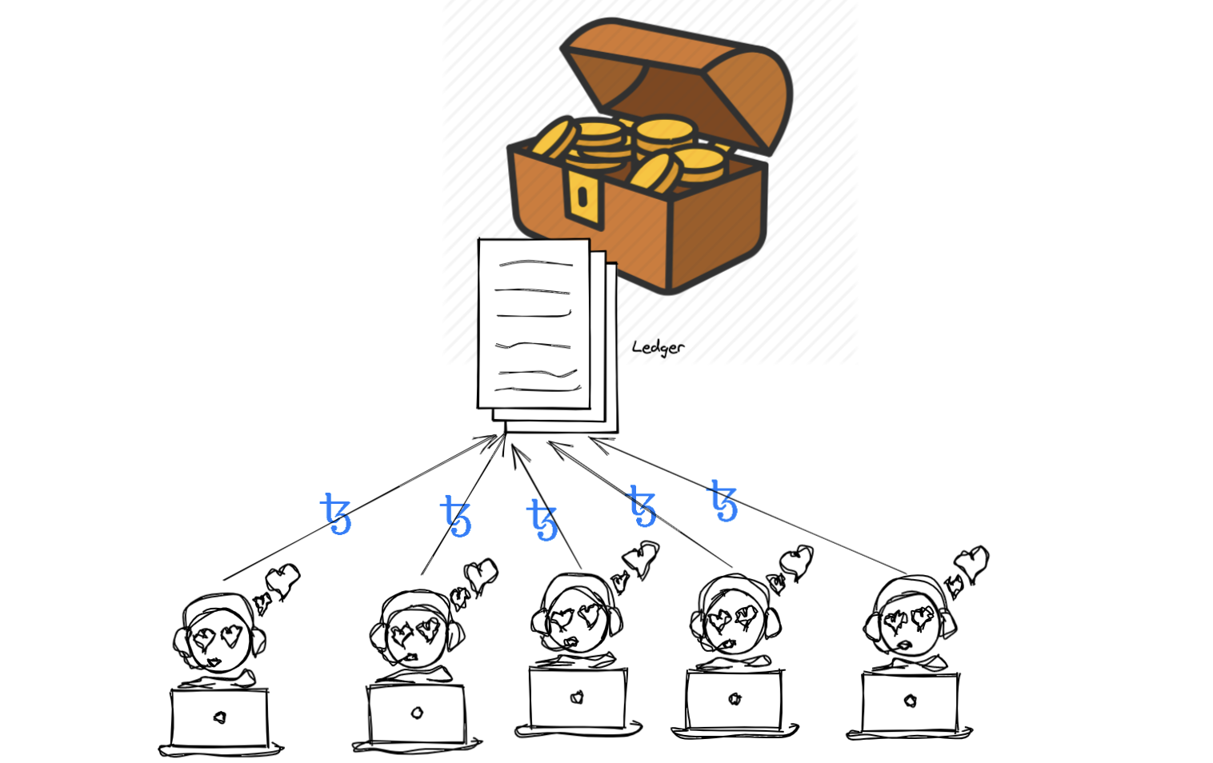
User story: Funding
1.Decentralized Funding
2.Prevent project from Pre-Run Attack

Slide 11
For DAO Founder
Airdrop
Salary
Create DAO
Setting for Evaluation
Setting RANK
Voting
……
Soul Account
Incentive System

Slide 12
For Dao Members
Airdrop
Salary
Choose a DAO
Mint SBT to join
Contribute
Voting
……
Soul Account

Slide 13
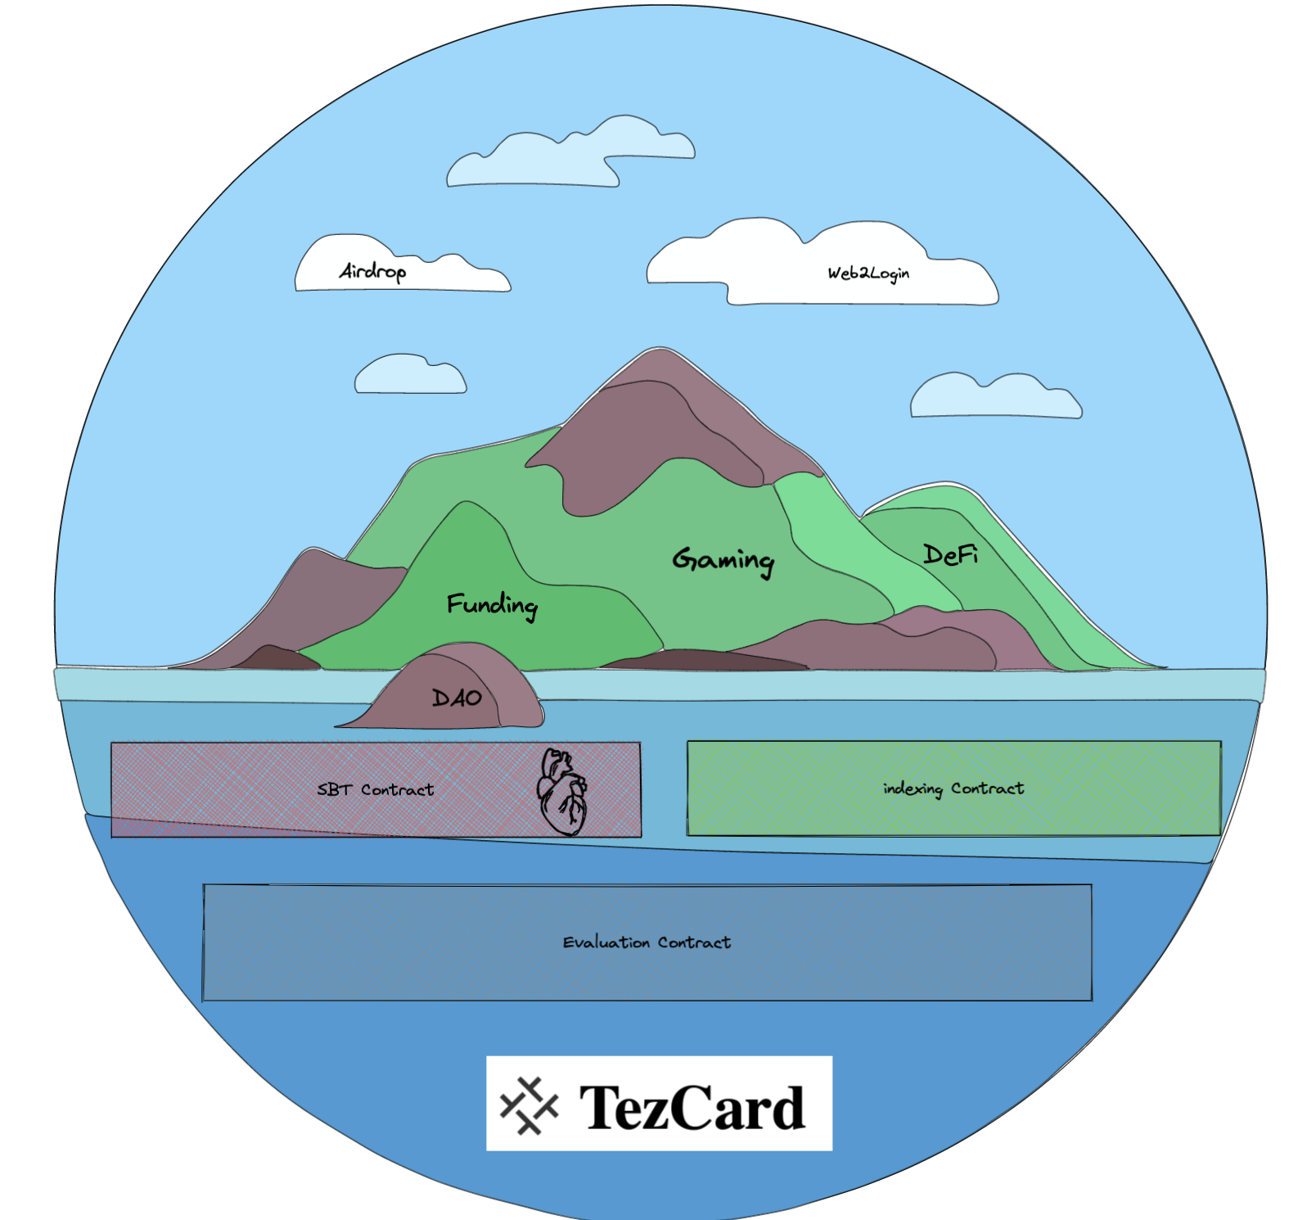
The TezCard World
Evaluation Contract
SBT Contract Contract
Indexing Contract
1.Evaluation Contract supplies the base toolset
2.SBT Contract supplies the DID
3.Indexing Contract supplies on-chain indexing for queries

Slide 14
TezCard vs Others
 | NOOX | DAOU | Colony | TezCard
SBT | ✅ | ✅ | ❌ | ✅
SoulAccount Creation | ❌ | ❌ | ❌ | ✅
Voting | ❌ | ✅ | ✅ | ✅
Funding | ❌ | ❌ | ✅ | ✅
Setting for Evaluation | ❌ | ❌ | ✅ | ✅
Web2 Login | ❌ | ❌ | ❌ | ✅

Slide 15
Roadmap
Phase
Phase
Phase
Phase
01
02
03
04
Hackthon：
1.Complete the SBT and Evaluation contracts;
2.Complete the Factories Evaluation system;
1.Complete Indexing Contract;
2.Demo of Web2Login and SDK;
Complete Voting and Funding contract or other tool contracts.
Lunch Mainet, start contribute the ecosystem.

Slide 16


Slide 17
Demo

